Slide 1
Final project
136010-1 Introduction to DH Tools and Methods
Nesytova Olga

Slide 2
Motivation
In this Project I am exploring cardiovascular diseases prediction dataset.
Predictive medicine is currently in high demand. By using individual health data, such as body mass index and blood pressure measurements, we can predict the risk of various diseases for an individual. This enables early detection of illnesses or prescription of preventive therapies, ultimately extending life and improving the quality of life for individuals.
MedTech is the field where I worked for two years and where I aim to continue my career.

Slide 3
Example of case
Suppose I work in an IT company that collaborates with the city administration. They are planning medical events and provide our company with non-personal data obtained from an insurance company or medical organization.
It is necessary to assist the clients in developing therapeutic and preventive plans

Slide 4
Research questions
In which age groups is the risk of cardiovascular diseases higher?
How many people are smokers?
Who is more affected by obesity: men or women? In which age groups?

Slide 5
Methodology
Obtain the data and analyze its composition.
Calculate the risk of cardiovascular diseases for each row using the formula provided by the client.
Generate graphs based on the conditions specified by the client.
Analyze the obtained information.
Submit the diagrams to the client for developing plans for therapeutic and preventive activities

Slide 6
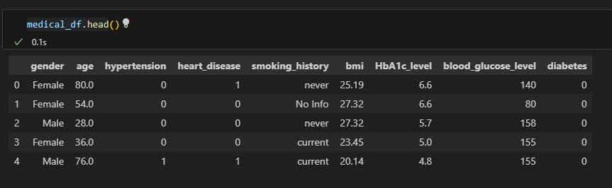
Data structure

Slide 7
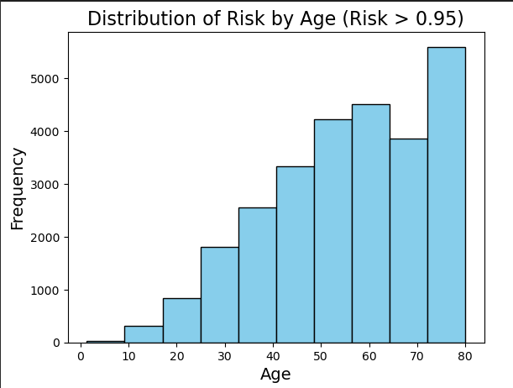
Results
People aged 49 to 64 and 72 to 80 are most susceptible to the risk of cardiovascular diseases
It is necessary to implement therapeutic and preventive activities for individuals over 50 years old.

Slide 8
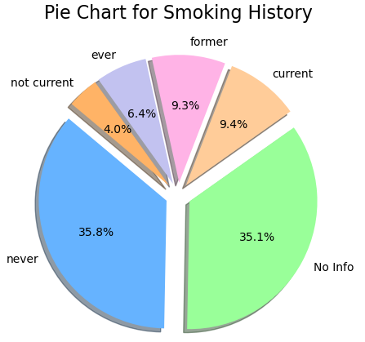
Results
The percentage of smokers is 9.4%
A significant portion of rows lacks information. Additional research is required to draw conclusions.

Slide 9
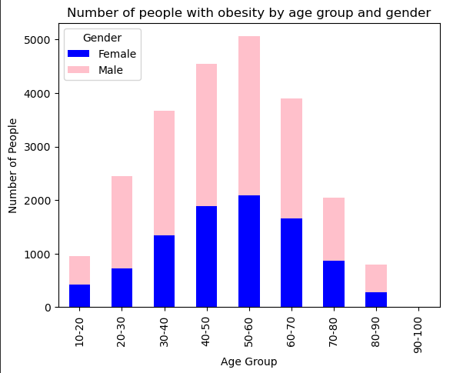
Results
Men aged 40 to 60 are most susceptible to obesity. (Obesity is diagnosed when the body mass index is over 30)

Slide 10
Conclusion
In which age groups is the risk of cardiovascular diseases higher?
People aged 49 to 64 and 72 to 80
How many people are smokers?
Insufficient data for a reliable conclusion
Who is more affected by obesity: men or women? In which age groups?
Men aged 40 to 60

Slide 11
Data processing steps

Slide 12
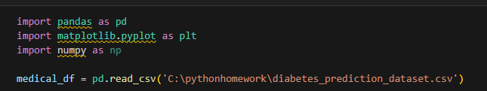
Data processing steps
1. At first import libraries and create data frame from csv-file

Slide 13
Data processing steps
2. Display a few rows on the screen to understand the composition of the data. Output information about the data types in the columns

Slide 14
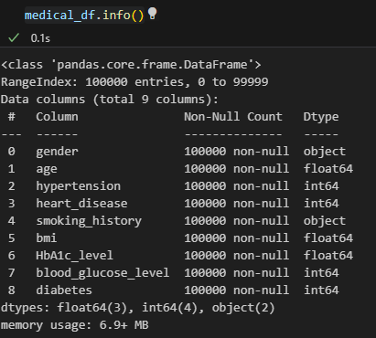
Data processing steps
3. Output information about the data types in the columns

Slide 15
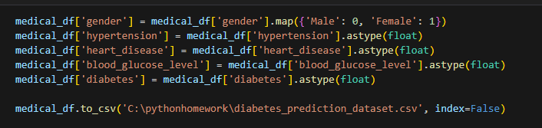
Data processing steps
4. For subsequent calculations, it is necessary to represent the 'gender' column in the format of '0' and '1' and change the data type of certain columns

Slide 16
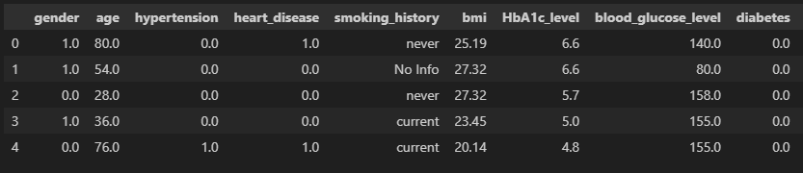
Data processing steps
5. Verify the changes. The code executed successfully

Slide 17
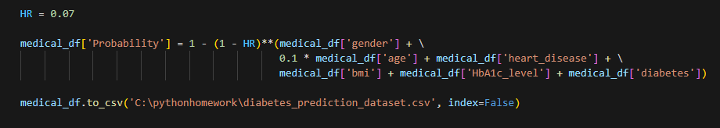
Data processing steps
6. To answer the question of which age groups have a higher risk of cardiovascular diseases, it is necessary to create a new column in the file and calculate this risk using the formula provided by the client

Slide 18
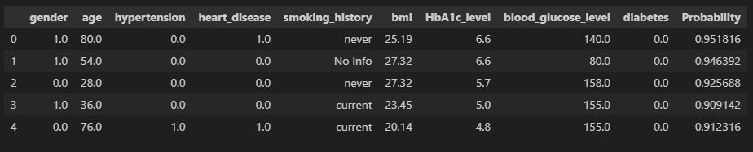
Data processing steps
7. Verify the changes.

Slide 19
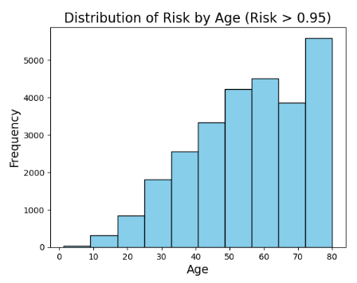
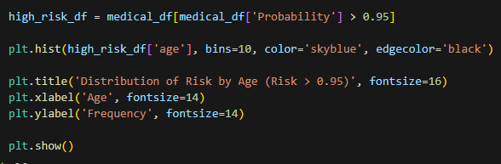
Data processing steps
8. Construct a diagram illustrating the distribution of high risk by age (risk above 0.95)

Slide 20
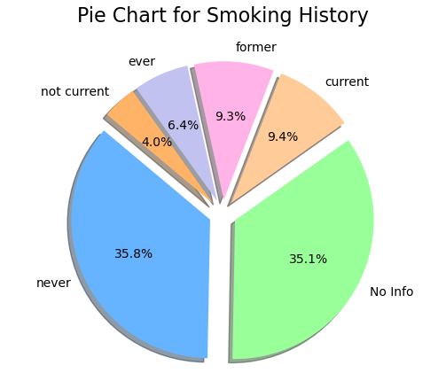

Data processing steps
9. Create a pie chart showing the percentage distribution of smokers

Slide 21

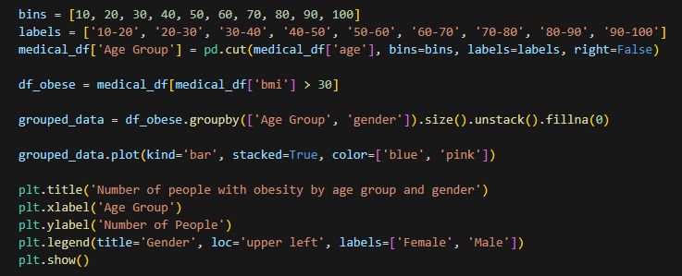
Data processing steps
10. Construct a bar chart illustrating the age category with a higher number of individuals with obesity, segmented by gender

